Slide 1
Review
♦ Domain model
    Conceptual classes & attributes
    Association & multiplicity
♦ System sequence diagram

Slide 2
Domain model
Applying UML and Patterns
-Craig Larman

Slide 3
Domain model representation?
A domain model is a visual representation of real world concepts (real-situation objects ), that could be : idea, thing , event or object…..etc .
  Business objects - represent things that are manipulated in the business e.g. Order.
  Real world objects – things that the business keeps track of e.g. Contact , book.
  Events that transpire - e.g. sale, loan and payment.

Slide 4
Method1: Noun Phrase Identification
Identify Nouns and Noun Phrases in textual descriptions of the domain that could be :
  The fully dressed Use Cases
  The problem definition.
But not strictly a mechanical process. Why ?
  Words may be ambiguous ( such as : System )
  Different phrases may represent the same concepts.

Slide 5
Method2 : By Category List (read p 140-141)
Common Candidates for classes include:
  Descriptions , Roles , Places , Transactions
  Containers , Systems , abstract nouns , Rules
  Organizations, Events, Processes, catalogs , Records , services.

Slide 6
Attributes
A logical data value of an object.
Imply a need to remember information.
  Sale needs a dateTime attributte
  Store needs a name and address
  Cashier needs an ID
Use case scenarios are examined to discover also attributes

Slide 7
A Common Mistake when modeling the domain- Classes or Attributes?
Rule
If we do not think of a thing as a number or text in the real world, then it is probably a conceptual class.
If it takes up space, then it is likely a conceptual class.
Examples:
Is a store an attribute of a Sale ?
Is a destination an attribute of a flight ?

Slide 8
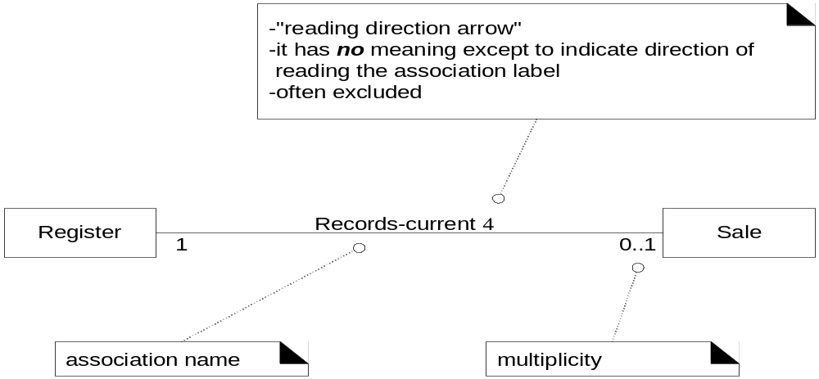
Association
Relationship between classes (more precisely, between instances of those classes)indicating some meaningful and interesting connection

Slide 9
Common association list
A is a physical part of B .
    Wing - Airplane
A is a logical part of B
    SalesLineItem - Sale
A physical contained in B
    Register-Sale

Slide 10
Common association list
A is a logical contained in B
      ItemDescription - Catalog
A is a description of B .
      ItemDescription - Item
A is a member of B
      Cashier – Store
A uses or manage B
      Cashier-Register

Slide 11
Common association list
A is recorded in B
      Sale-Register
A is an organization subunit of B .
      Departement - Store
A communicate with B
      Customer - Cashier

Slide 12
Common association list
A is related to a transaction B
      Customer - Payment
A is a transaction related to another transaction B .
      Payment - Sale
A is owned by B
      Register - Store
A is an event related to B
      Sale- Customer

Slide 13
High priority association
Association
  A is a physical or logical part of B
  A is physically or logically contained in/on B
  A is recorded/known/reported / captured in B
NB:
  Avoid showing redundant or derivable associations
  Do not overwhelm the domain model with associations not strongly required

Slide 14
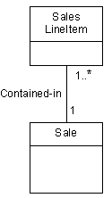

Examples
Sale is recorded in a register
SalesLineItem is a logical part of Sale

Slide 15
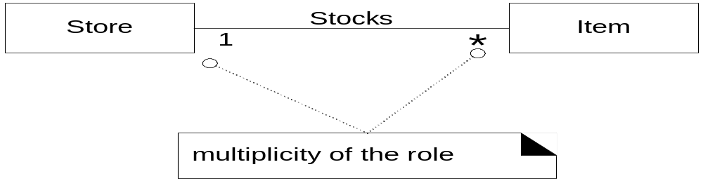
“many”
( 0 or more )
Multiplicity
Multiplicity indicates how many instances can be validly associated with another instance, at a particular moment, rather than over a span of time.
    Example : monogamy

Slide 16
System Sequence diagram
Applying UML and Patterns
-Craig Larman

Slide 17
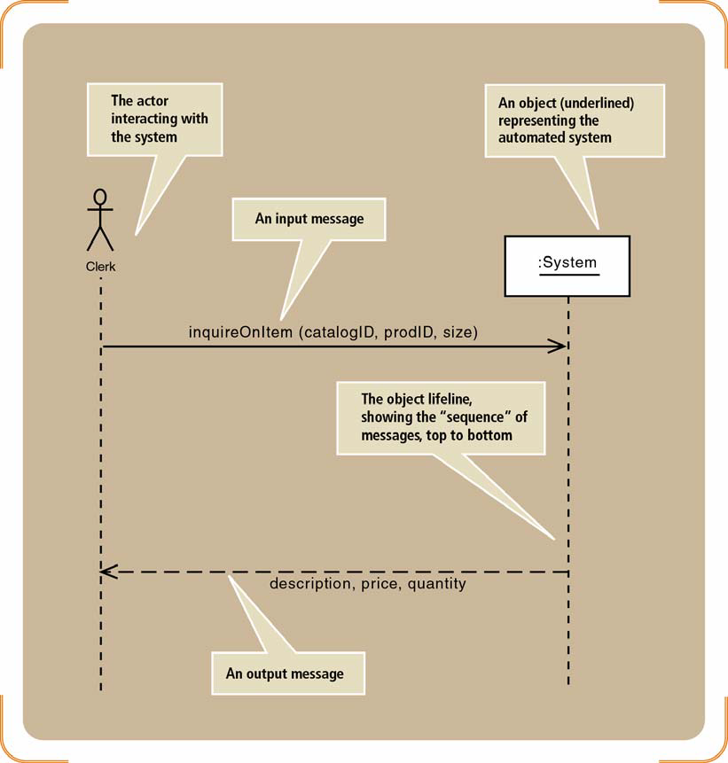


Slide 18
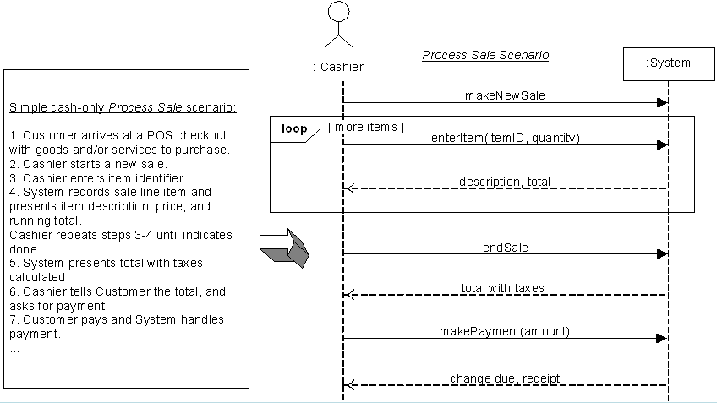
Relationship SSD and Use case
Develop SSDs for the main success scenario of a selected use case, then frequent alternative scenarios

Slide 19
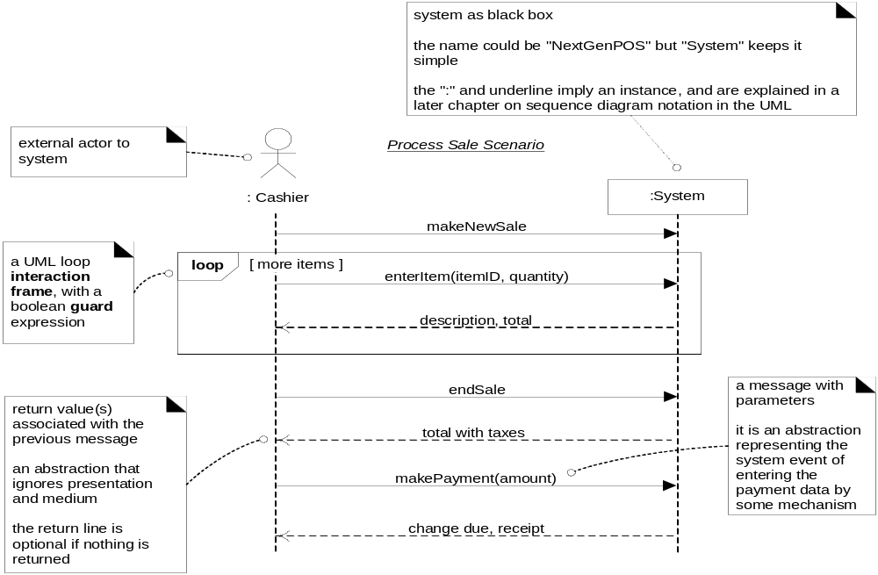
Process Sale

Slide 20
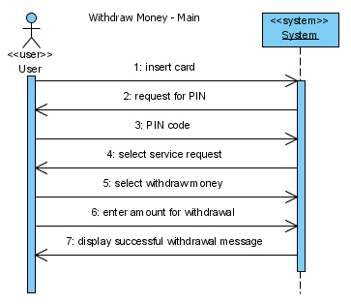
Example

Slide 21
Car rental system

Slide 22
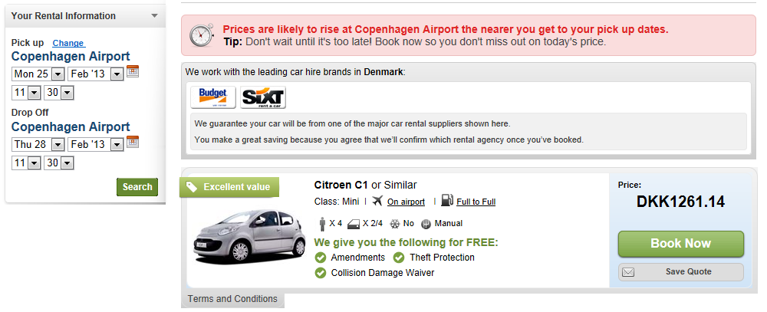
Car rental system

Slide 23
Use case : rent a car
The use case begins when the customer selects ”Book Now”.
The system displays the available cars
The customer selecst the type of car in the checkbox that contains:
    Sport cars
    Station wagon
    Normal
The system displays the list of available cars

Slide 24
Use case : rent a car
The customer enters the pick-up/ drop-off date and place.
The system displays cars availbale with the fair
The customer selects the requested car.
The system display a confirmation screen that contains:
    The car rented
    Pick up/ drop off date and place
    Amount the customer has to pay
The user confirms the criteria and the use case ends.

Slide 25
Chap 11
Operation Contracts
Chapter 11
Applying UML and Patterns
-Craig Larman

Slide 26
Operation Contract
Operation contract identifies system state changes when an operation happens.
Define what each system operation does
An operation is a single event from the system sequence diagram
A domain model is used to help generate an operation contract

Slide 27
Operation Contract
When making an operation contract, think of the state of the system before the action and the state of the system after the action.
The conditions both before and after the action should be described in the operation contract.
The pre and post conditions describe state, not actions.

Slide 28
Sections of an Operation Contract
Operation: Name of the operation and parameters
Cross References: Use cases and scenarios this operation can occur within
Preconditions: Noteworthy assumptions about the state of the system or objects in the Domain Model before execution of the operation.
Postconditions: This is the most important section. The state of objects in the Domain Model after completion of the operation

Slide 29
Postconditions: most important
Describe changes in the state of objects in the domain model after completion of the operation
    what instances were created ?
    what associations were formed/broken?
    what attributes changed?
Are not actions to be performed during the operation

Slide 30
Examples of Operation Contracts
From Process Sale Use Case

Slide 31
Main Success Scenario (or Basic Flow):
  1. Customer arrives at POS checkout with goods and/or services to purchase.
  2. Cashier starts a new sale.
  3. Cashier enters item identifier.
  4. System records sale line item and presents item description, price, and running total.
  Price calculated from a set of price rules.
  Cashier repeats steps 3-4 until indicates done.
  5. System presents total with taxes calculated.
  6. Cashier tells Customer the total, and asks for payment.
  7. Customer pays and System handles payment.

Slide 32
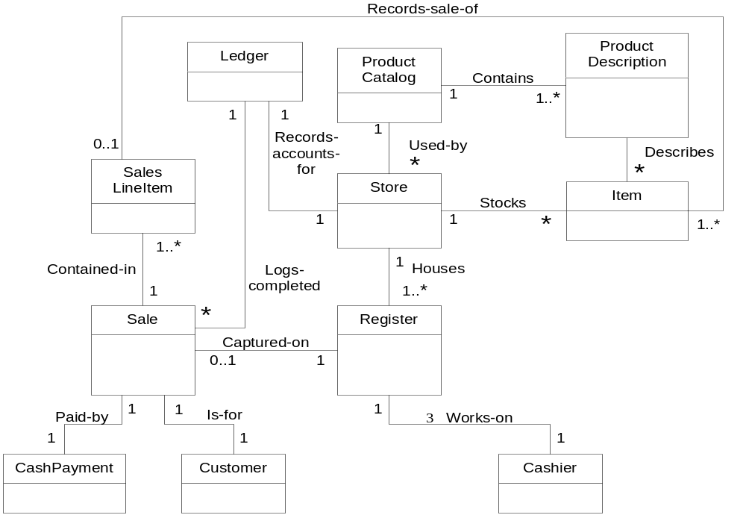
POS Domain Model

Slide 33
Operation Contract for makeNewSale operation
Operation: makeNewSale()
Cross References:
  Use Case: Process Sale
  Scenario: Process Sale
Preconditions: none
Postconditions
  a sale instance “s” was created (instance creation)
  s was associated with the Register (association formed)
  attributes of s were initialized

Slide 34
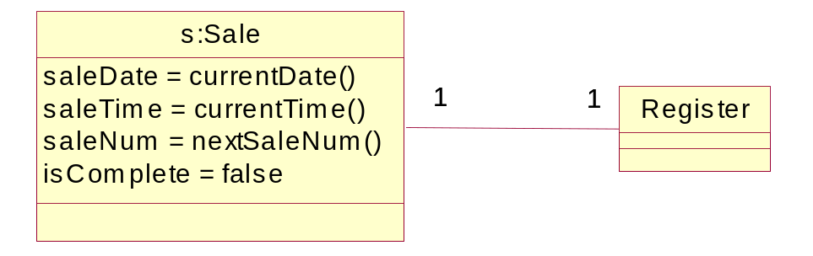
s:Sale was created
association was created
attributes of s:Sale were initialized

Slide 35
Operation Contract for enterItem operation
Operation: enterItem(itemID,quantity)
Cross References:
  Use Case: Process Sale
  Scenario: Process Sale
Preconditions: There is a sale underway.

Slide 36
Operation Contract for enterItem operation
Postconditions:
  A salesLineItem instance sli was created (instance creation)
  sli was associated with the current Sale (association formed)
  sli.quantity became quantity (attribute modification)
  sli was associated with a ProductDescription, based on itemId match (association formed)

Slide 37
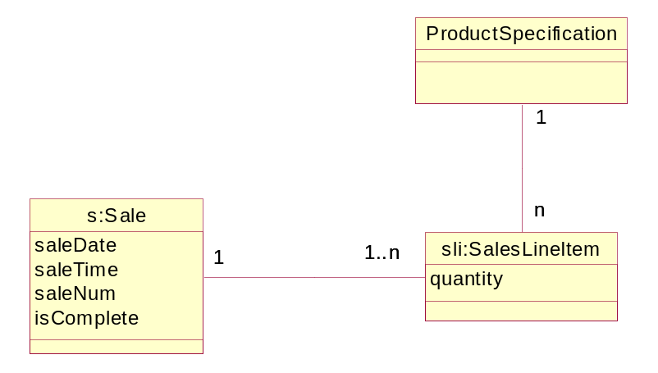
associations were created
sli.quantity was initialized to input quantity
sli:SalesLineItem was created

Slide 38
Operation Contract for endSale operation
Operation: endSale()
Cross References:
  Use Case: Process Sale
  Scenario: Process Sale
Preconditions: There is a sale underway
Postconditions
  s.isComplete became true (attribute modification)

Slide 39
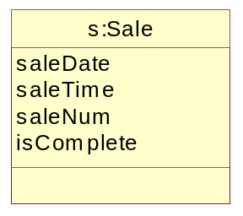
s.isComplete became true

Slide 40
Operation Contract for makePayment operation
Operation: makePayment(amount:Money)
Cross References:
  Use Case: Process Sale
  Scenario: Process Sale
Preconditions: There is a sale underway

Slide 41
Example—Operation Contract for makePayment operation
Postconditions
  a payment instance “p” was created (instance creation)
  p.amountTendered became amount (attribute modification)
  p was associated with s:Sale (association former)
  s:Sale was associated with the Store (association formed)

Slide 42
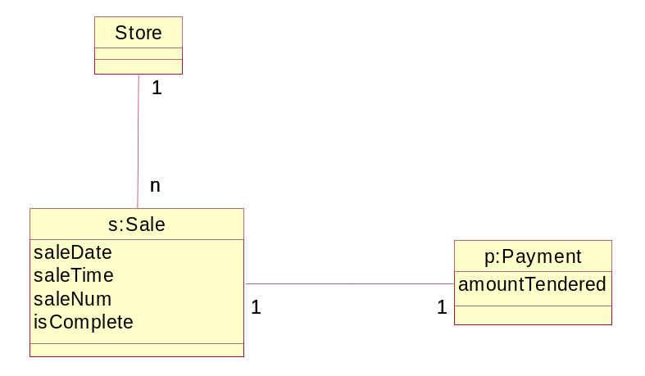
What this looks like:
associations were created
p.amountTendered was initialized to input amount
p:Payment was created

Slide 43
Why Operation Contracts?
An excellent tool of OO requirements analysis that describes in great detail the changes required by a system operation (in terms of the domain model objects) without having to describe how they are to be achieved
Excellent preparation for opening the System black box!

